Slide 1


TESA Top Gun
X BMERanger9

Slide 2







Humidity
Inspiration
Temperature
System
Human
Broken

Slide 3





Save money
Modern
Expectation
Save energy
Long range
User friendly

Slide 4

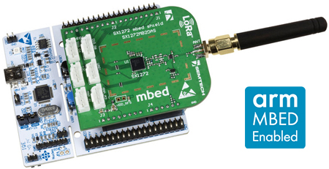


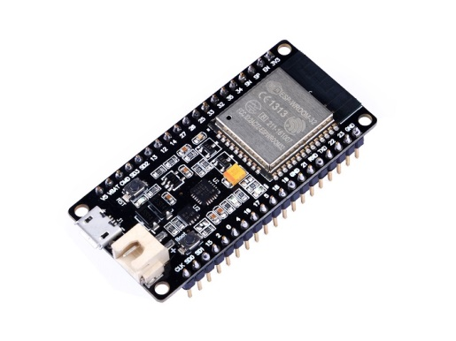
Architecture

Slide 5
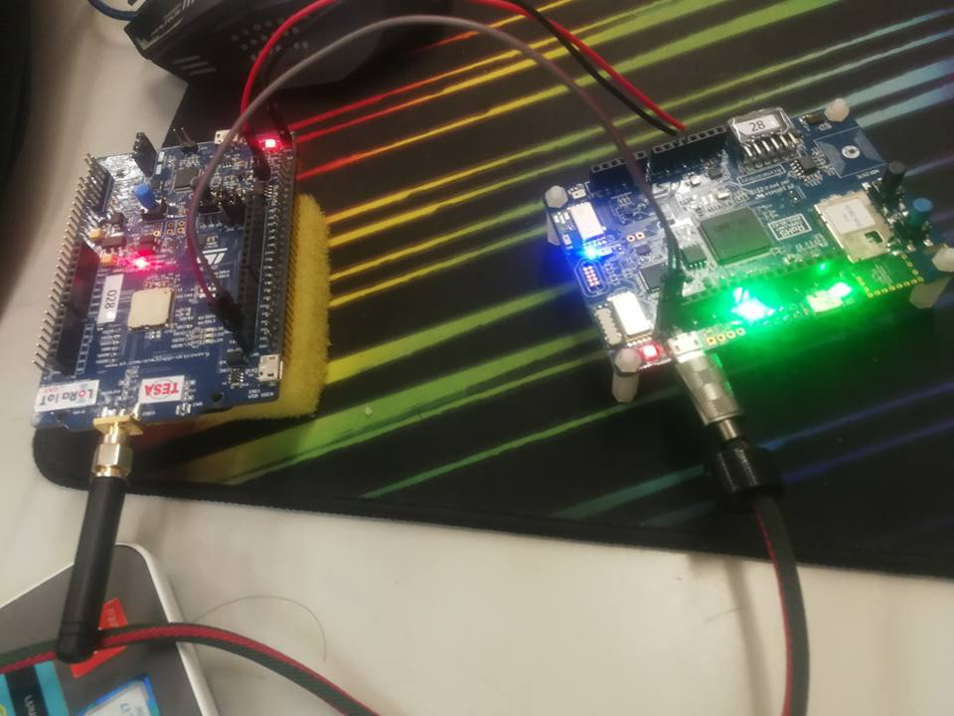
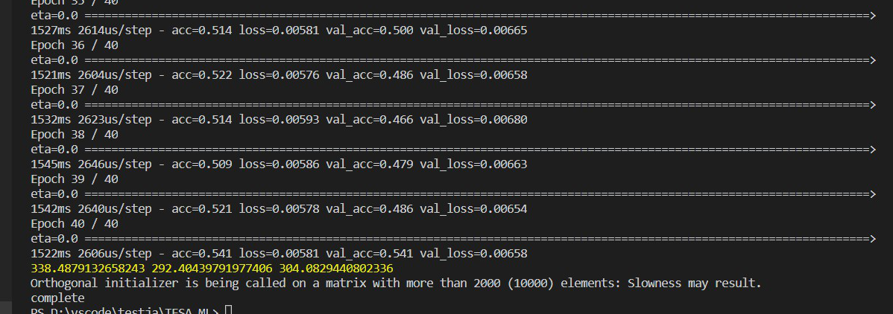
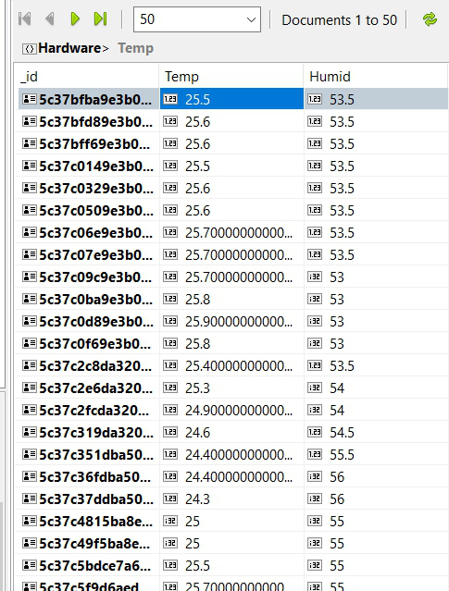
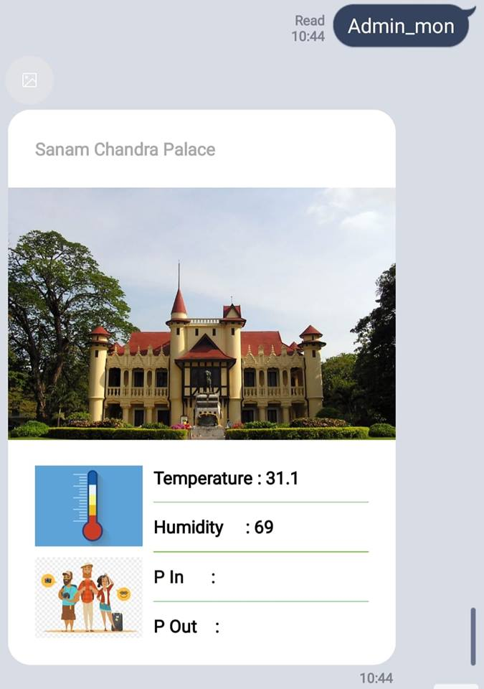
Achievement

Slide 6





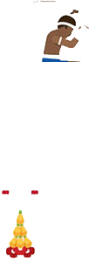

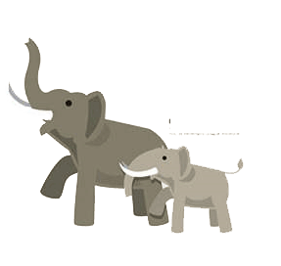
Opportunity

